Slide 1
WELCOME
TO THE
DEPARTMENT OF ECONOMICS
Nandini Mukherjee
HOD

Slide 2
ORIENTATION PROGRAMME: 2023 INDUCTION MEET Know your college

Slide 3
COLLEGE CAMPUS
Asutosh College Main Building
Humanities Building
ACTC Building
Research Building
Centenary Building
Bhasa Campus
Sports Ground-Maidan
ECONOMICS:
Asutosh College Main Building
Humanities Building

Slide 4
FACULTIES
DR. NANDINI MUKHERJEE : HOD (NM)
SUPARNA BASU: (SB)
DR. MANIPARNA SYAM ROY: (MSR)
SENJUTI GHOSH DAS : (SGD)
SHREYASEE DUTTA: (SD)

Slide 5
PROGRAMME
The B.A./ B.Sc. Programme shall be for a duration of Eight semesters (4 YEARS)
The Odd Semester in the month of July
The Even Semester in the month of January
Examination- November-December and May-June

Slide 6
COURSES
Major : SEM 1-8
Minor : SEM 1-6
Skill Enhancement Courses (SEC) : SEM 1-3
Ability Enhancement Course (AEC) : SEM 1-4
Common value added course(CVAC) : SEM 1-2
Inter Disciplinary Course (IDC) : SEM 1-3
Summer Internship
Dissertation

Slide 7
SEMESTER 1 (practical + theory)
Major- CC1-MICROECONOMICS I
SEC- SEC1- INTRODUCTORY STATISTICS & APPLICATION I
Minor- M1
AEC- Compulsory English
CVAC- ENVS; Constitutional values
IDC

Slide 8
PAPERS
Microeconomics
Macroeconomics
Development Economics
Mathematical Economics
Statistics for Economics
Indian Economics
Econometrics
International Economics
Environmental & Resource Economics
Public Economics
Financial Economics

Slide 9
TEACHING ,EVALUATION & OTHER DEPARTMENTAL ACTIVITIES
Class teaching
Interactive classes
Debate
Quiz
Tutorial/Remedial class
Class tests
Students seminar
Faculty seminar
Alumni lecture
Field trip
Workshops

Slide 10
OTHER COLLEGE ACTIVITIES & FACILITIES
Certificate courses
Computer courses
Career Counseling and training program (CCTP)
others
Placement Cell
College Committees
Central library
Seminar library
Guidance-Mentor-mentee program
Felicitation-Student achievement
Outreach and Extension Programme-Awareness generating program; Blood donation camp;
Subsidised Canteen
Cheap store-stationaries
Student Volunteers

Slide 11
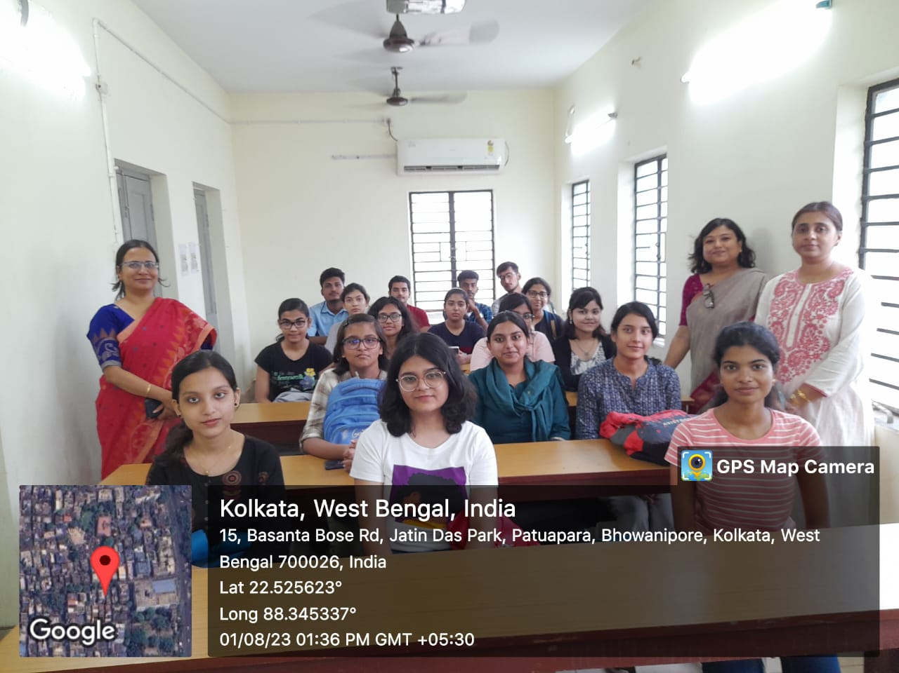
STUDENTS ORIENTATION-2023

Slide 12
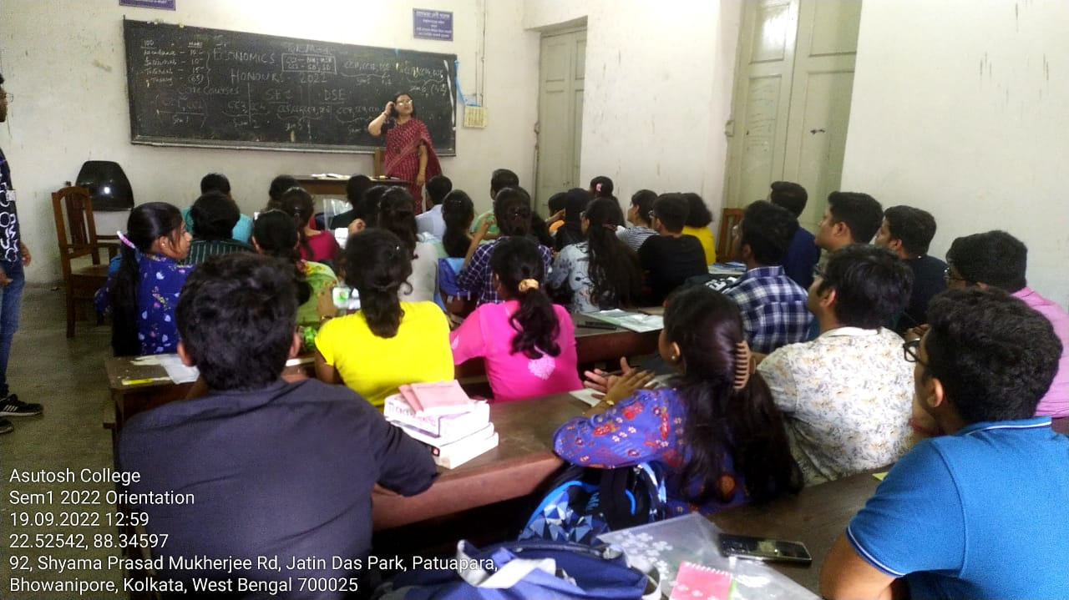
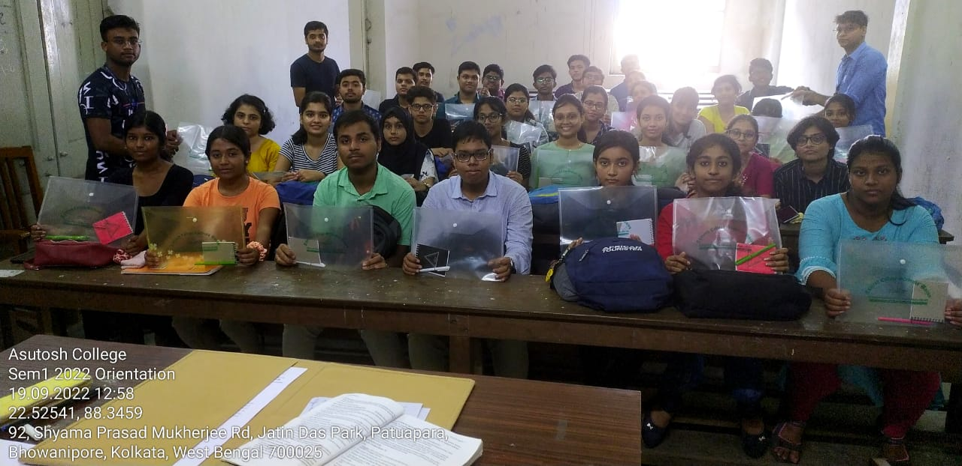
STUDENTS ORIENTATION-2022

Slide 13
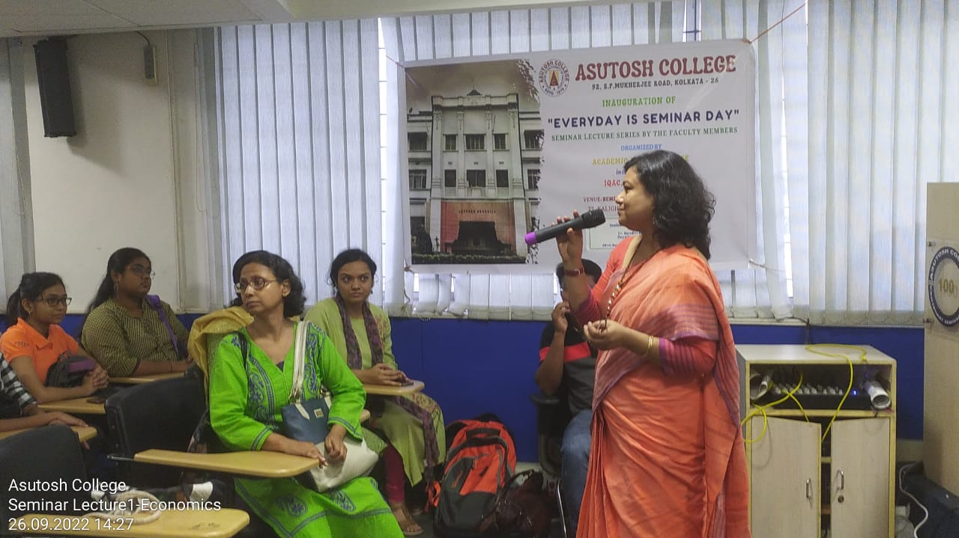
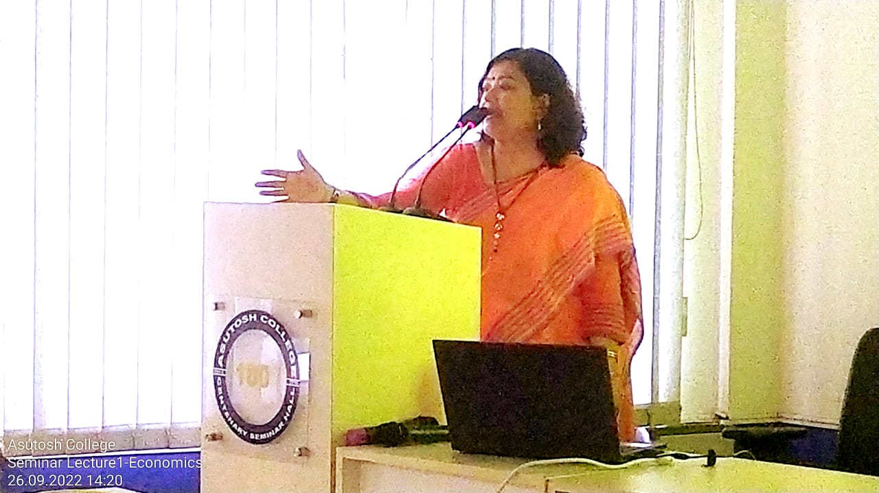
FACULTY SEMINAR

Slide 14
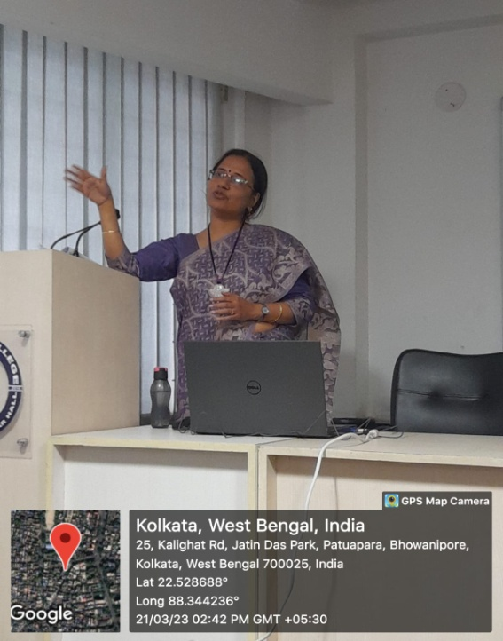
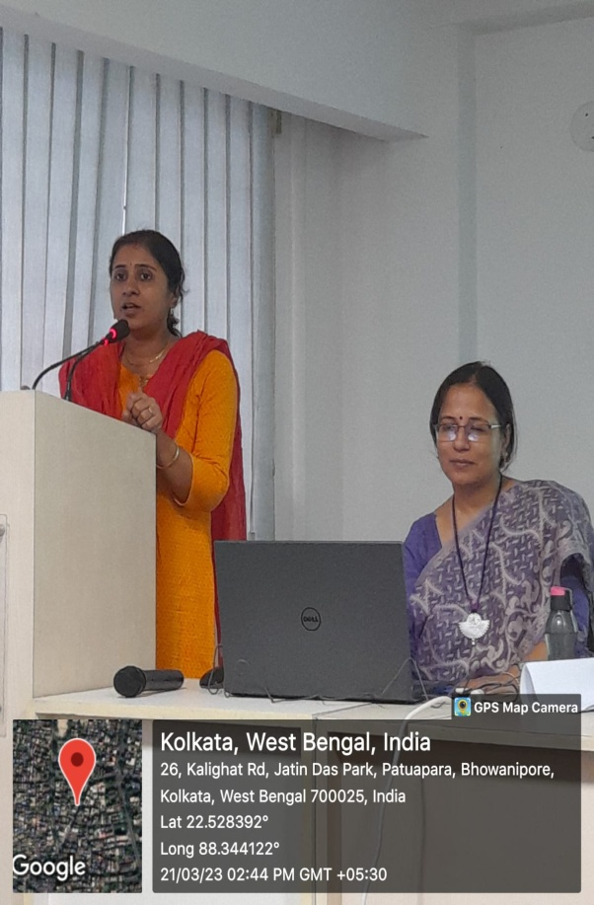
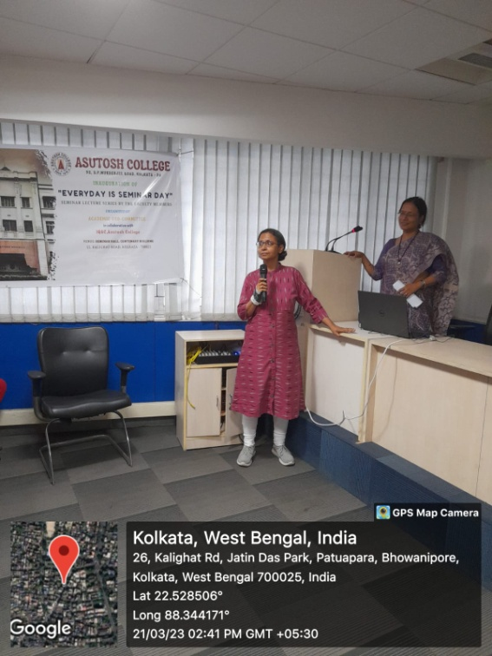

Slide 16
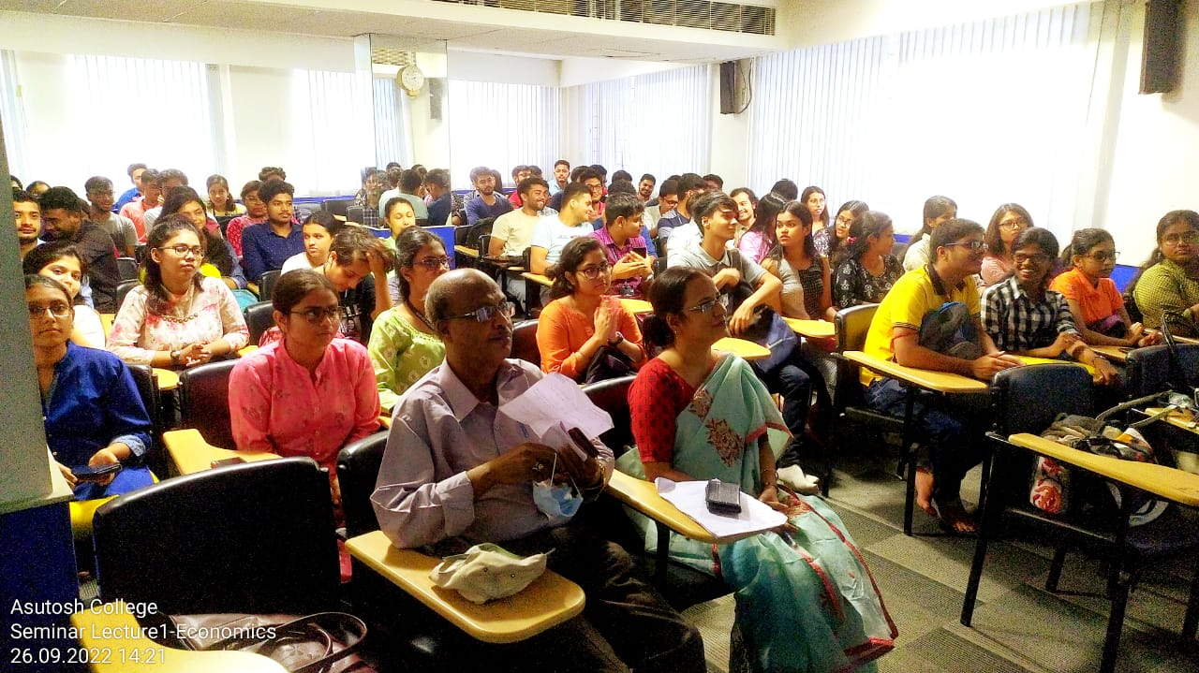

Slide 17
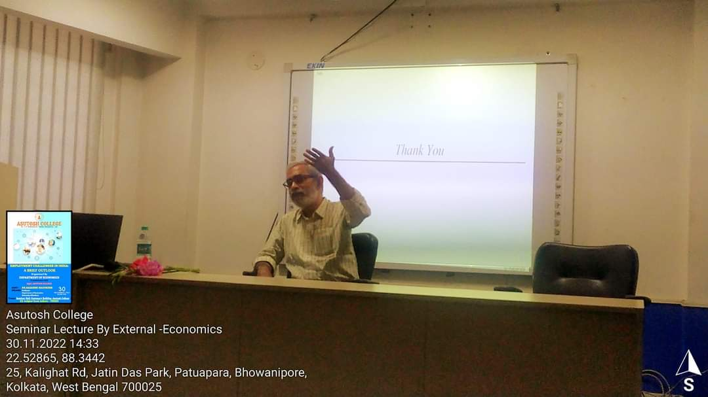
INVITED LECTURE

Slide 19
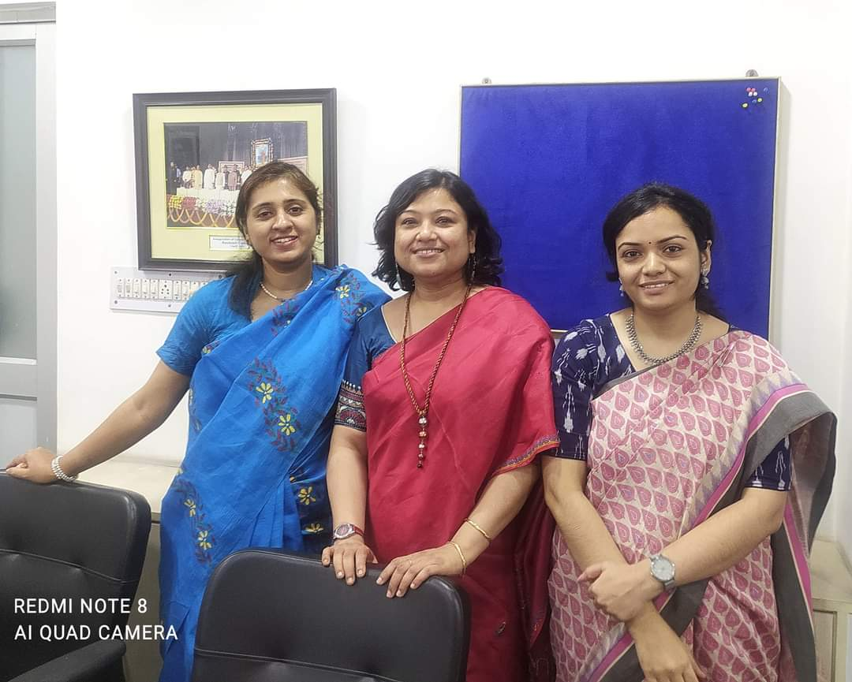
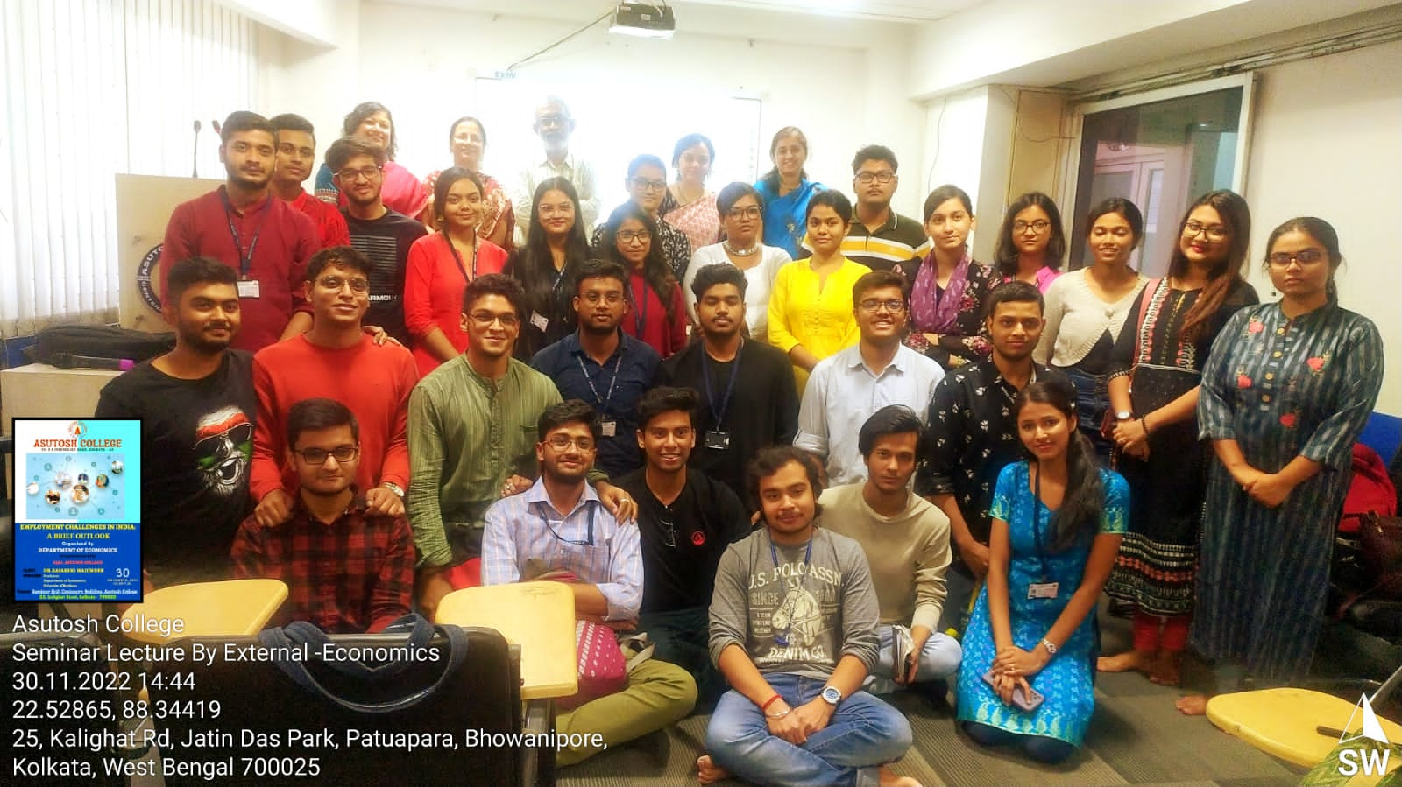

Slide 20
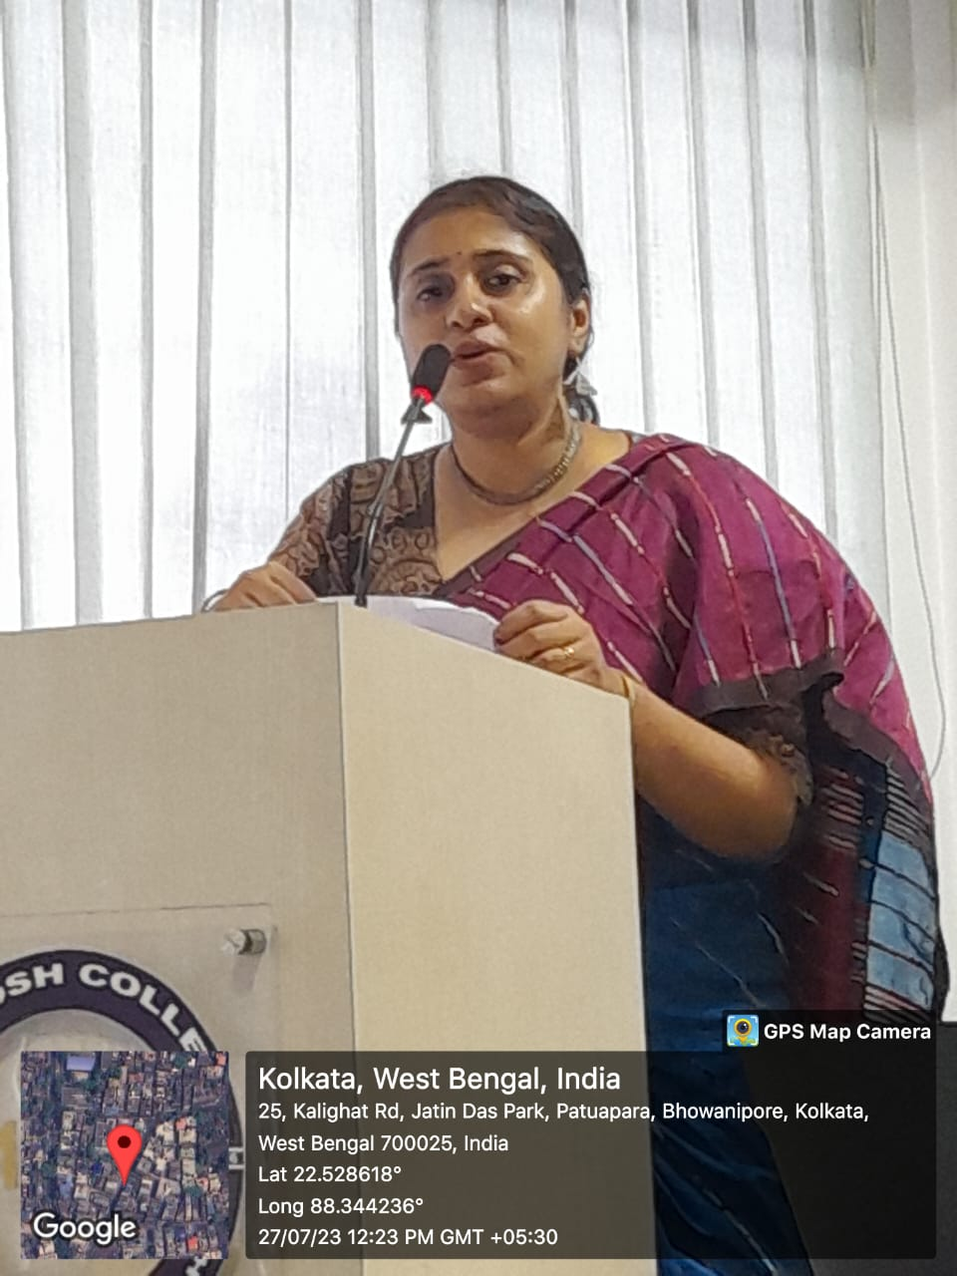
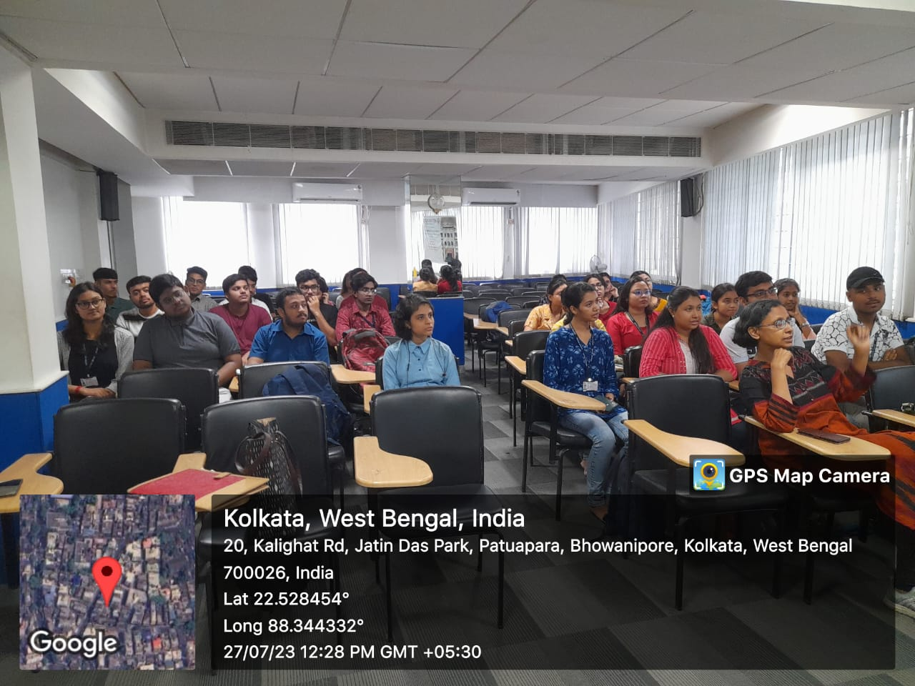
ALUMNI LECTURE

Slide 21
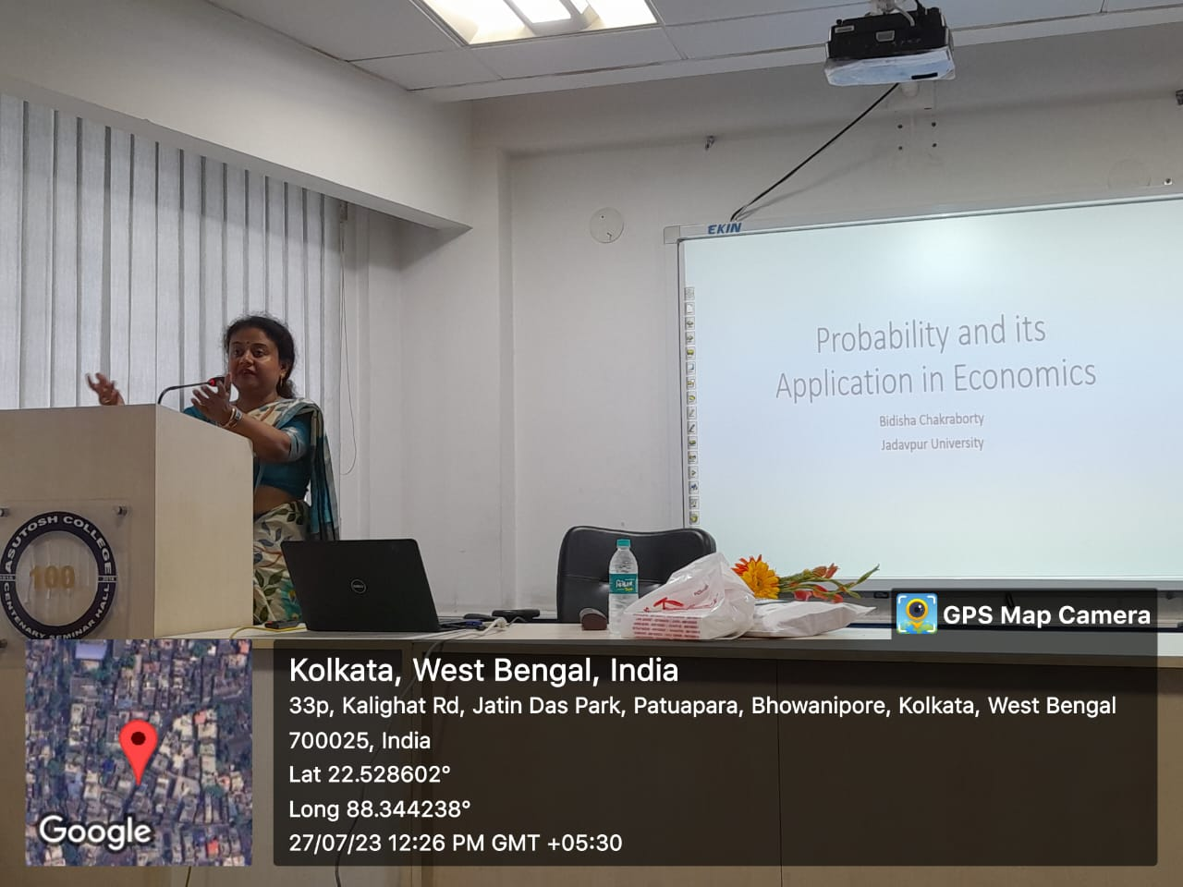
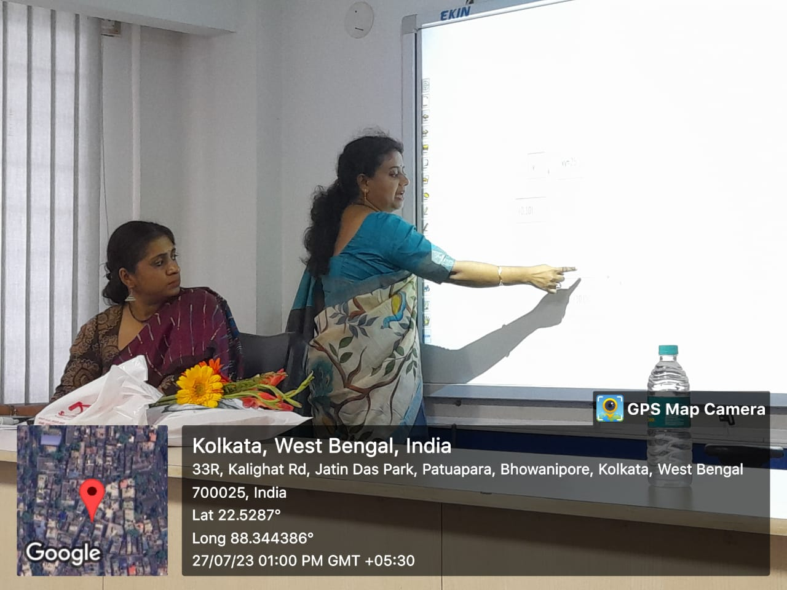

Slide 22
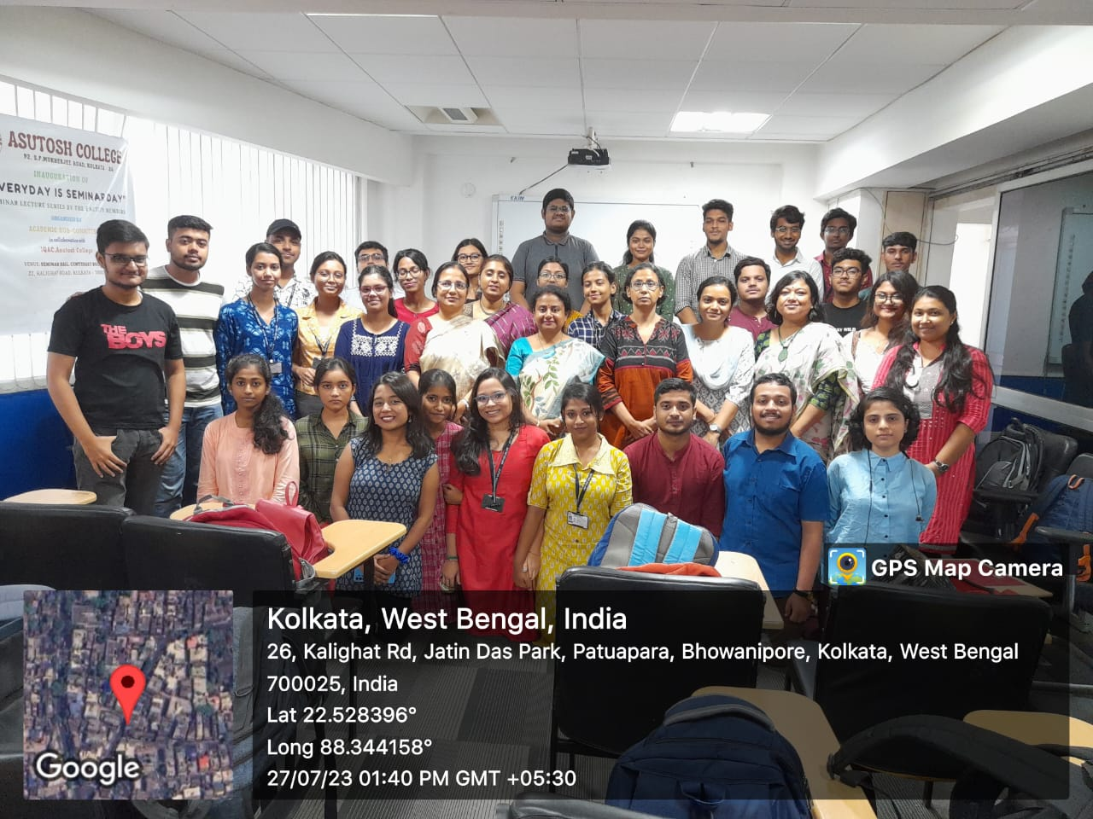

Slide 23
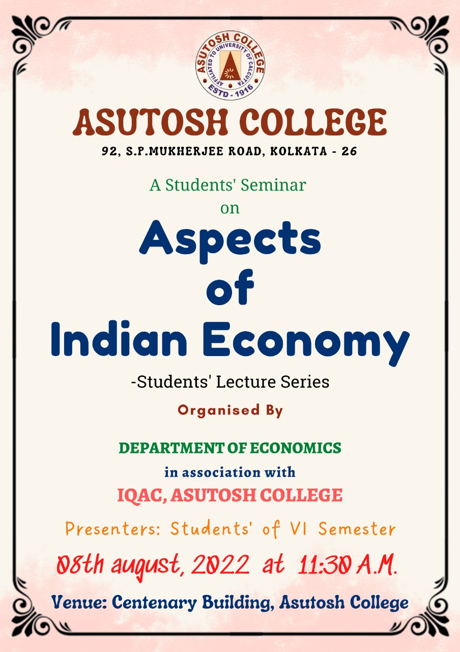
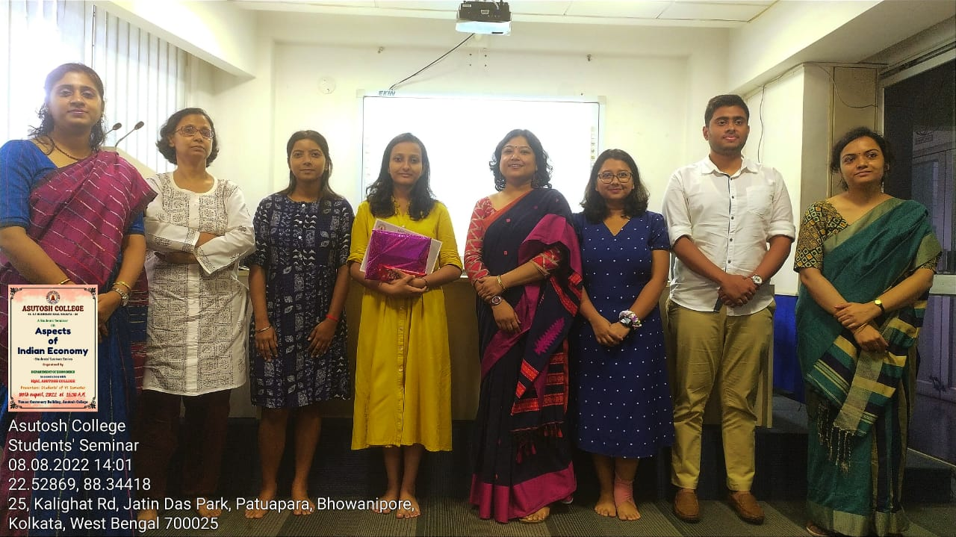
STUDENTS SEMINAR

Slide 24
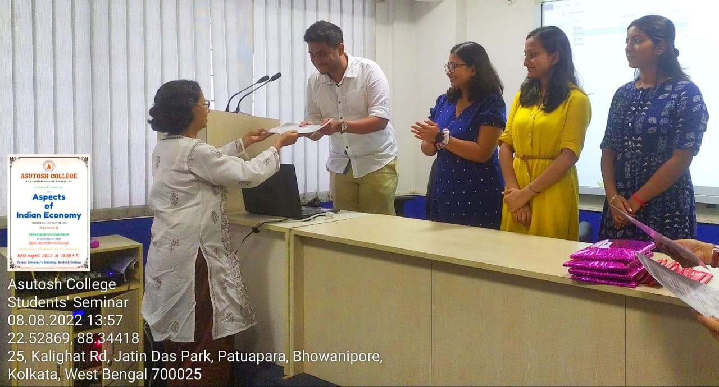
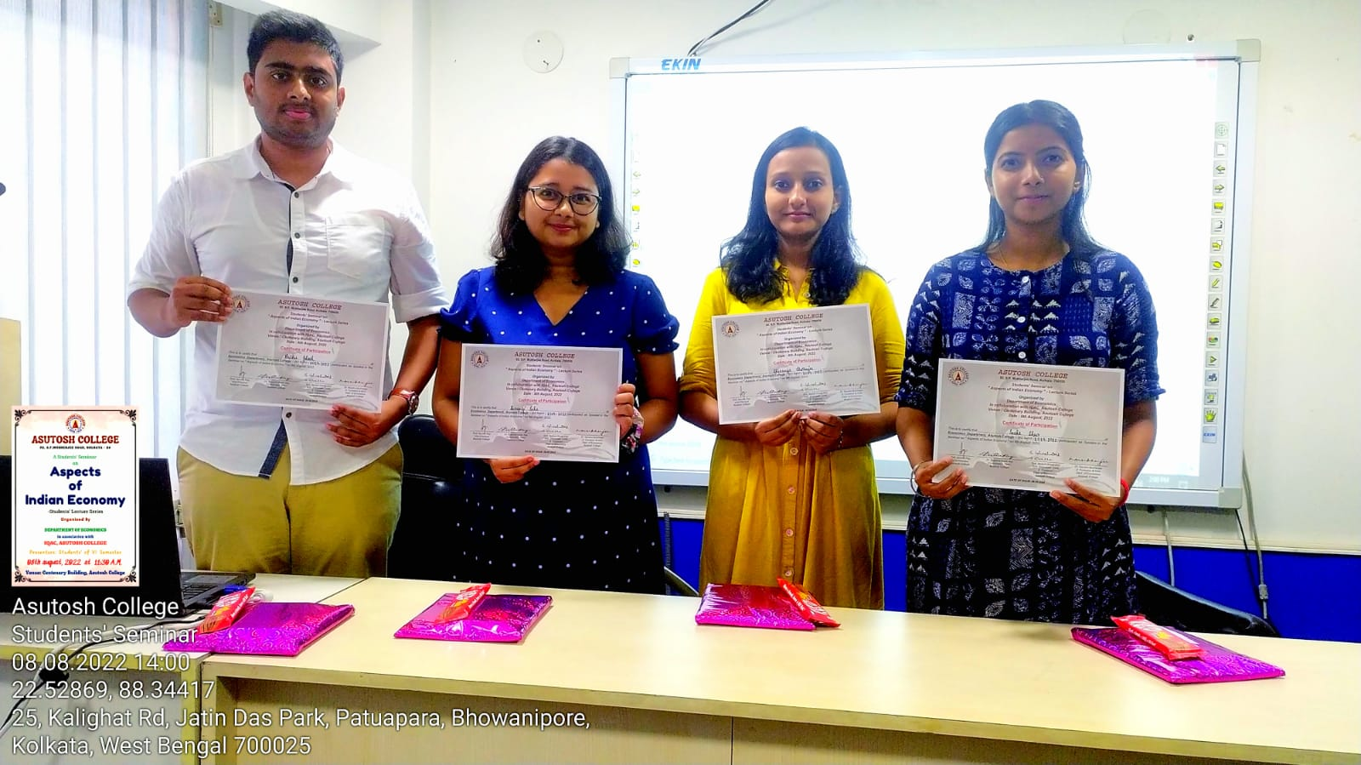

Slide 25
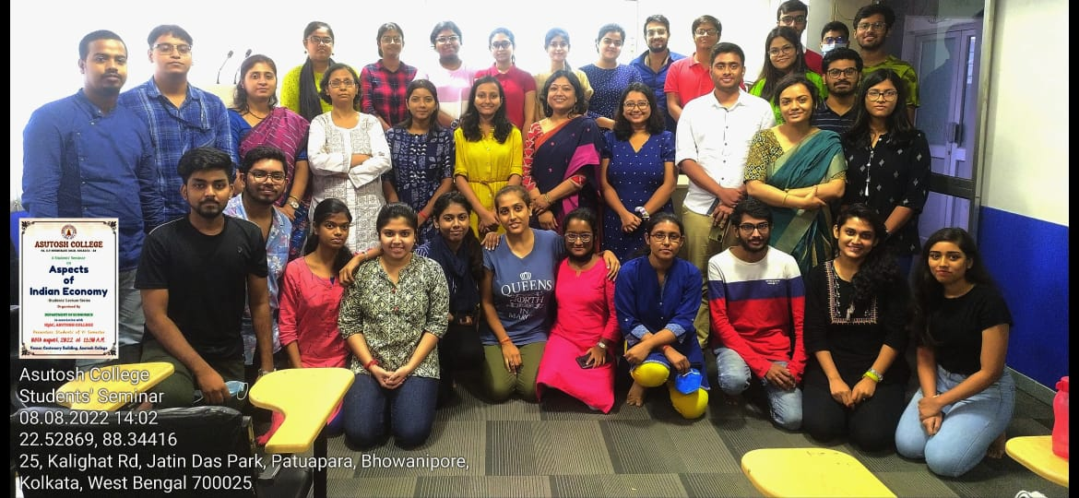

Slide 26
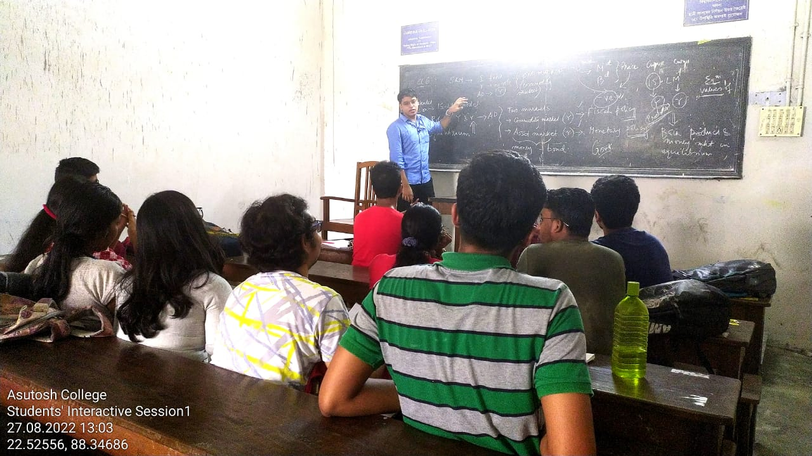
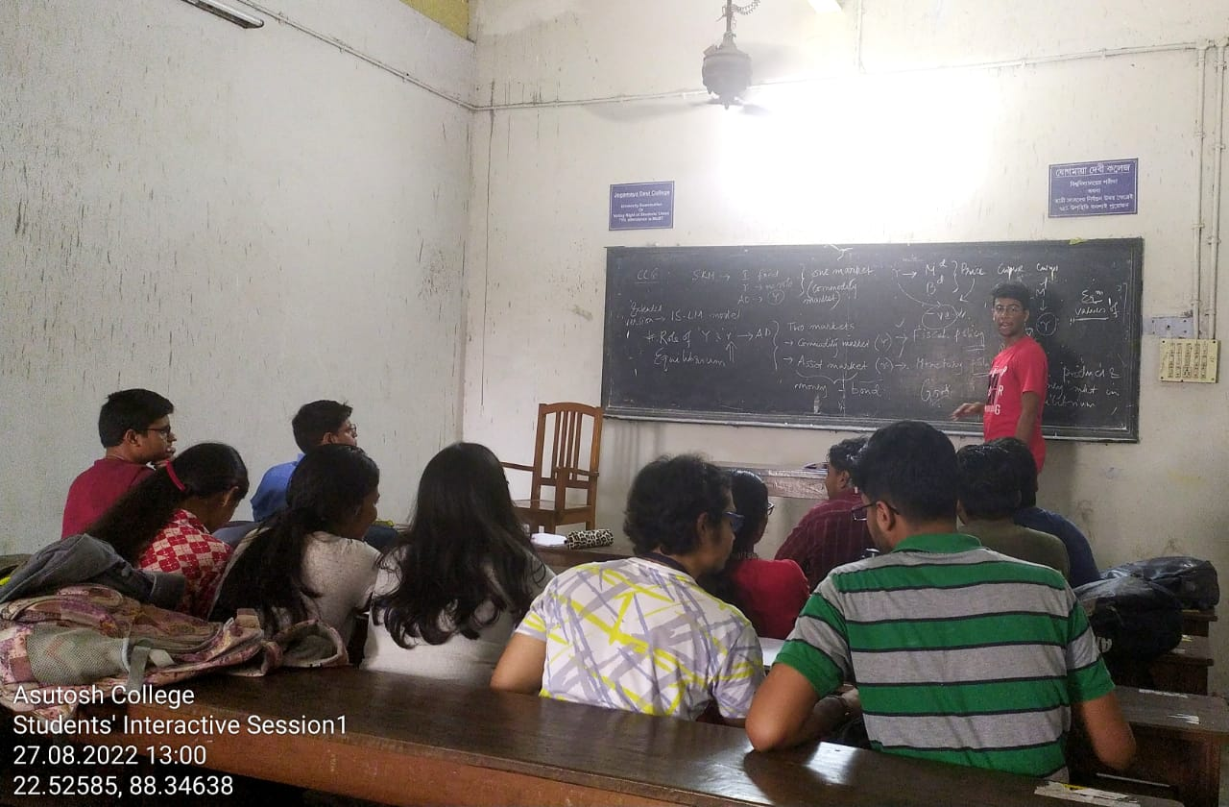
INTERACTIVE SESSION

Slide 27
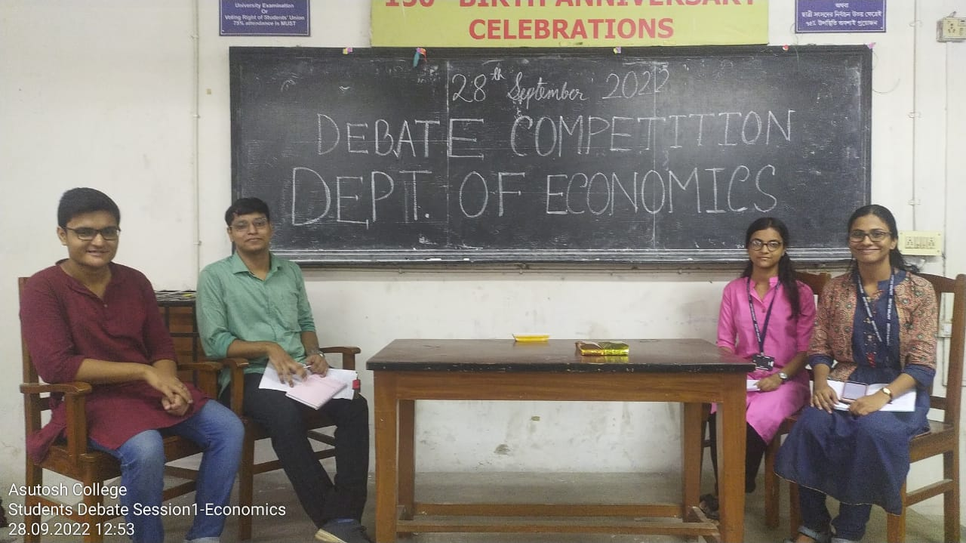
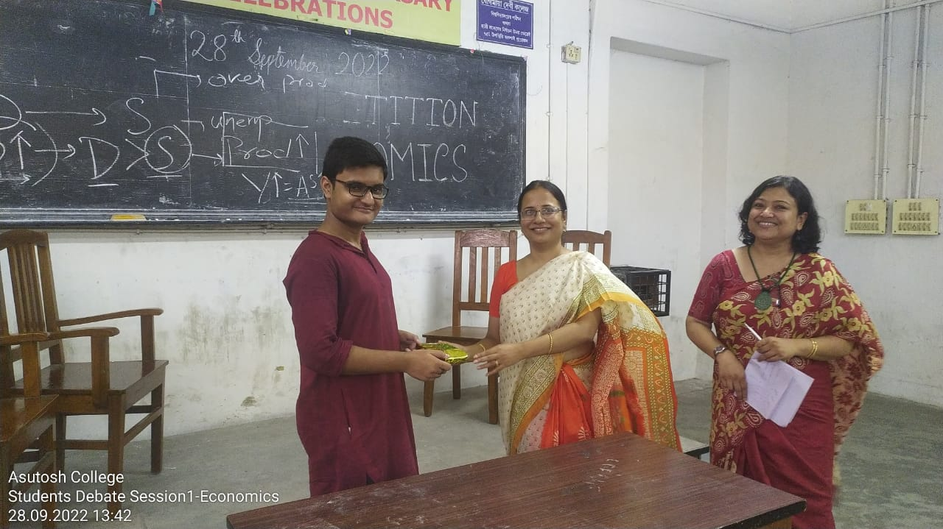
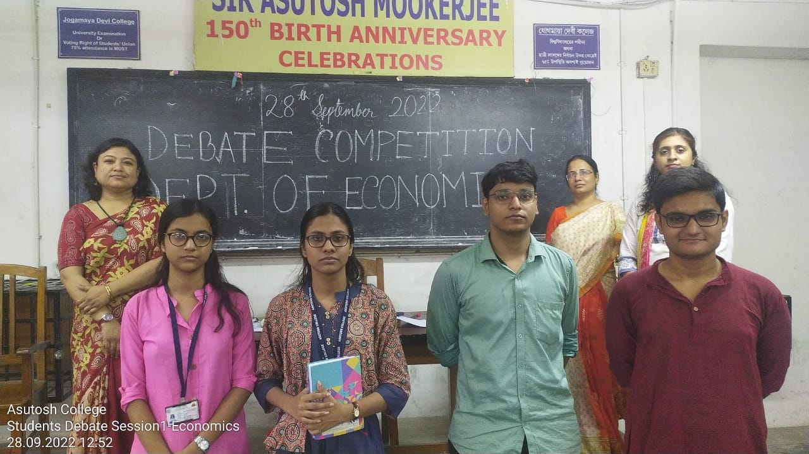
DEBATE SESSION

Slide 28
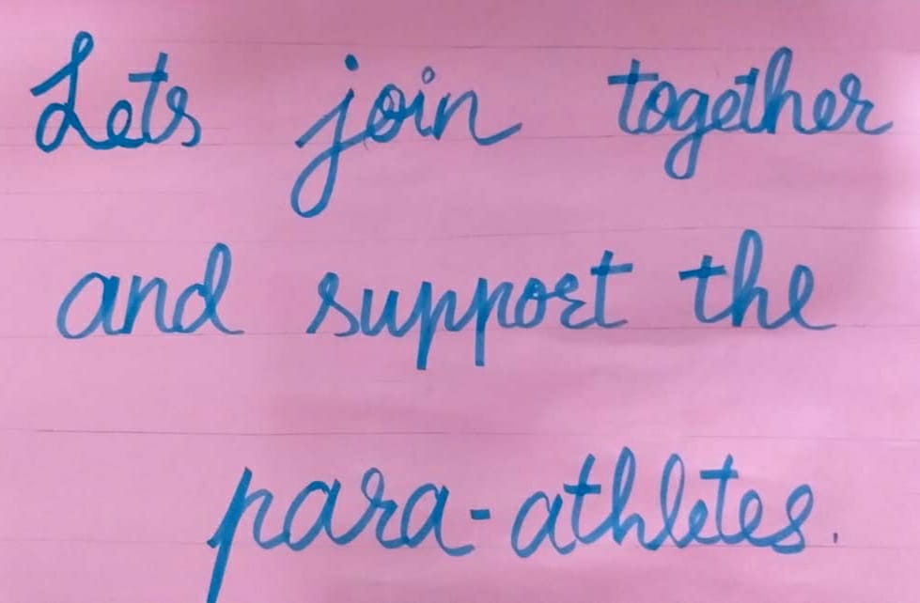
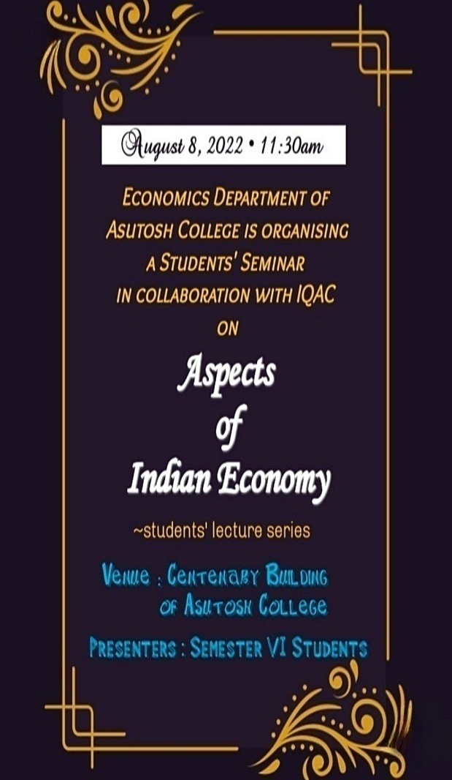
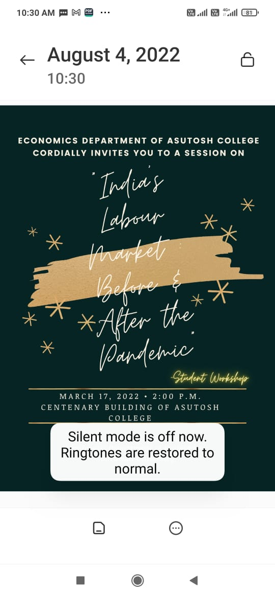
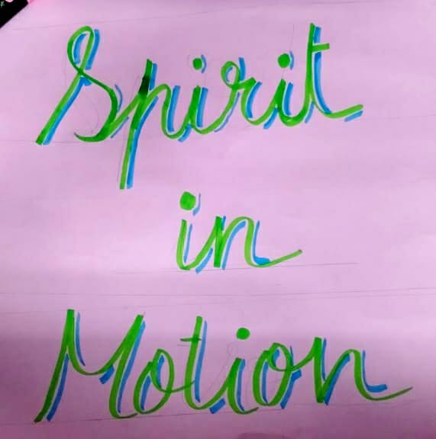
POSTER MAKING

Slide 29
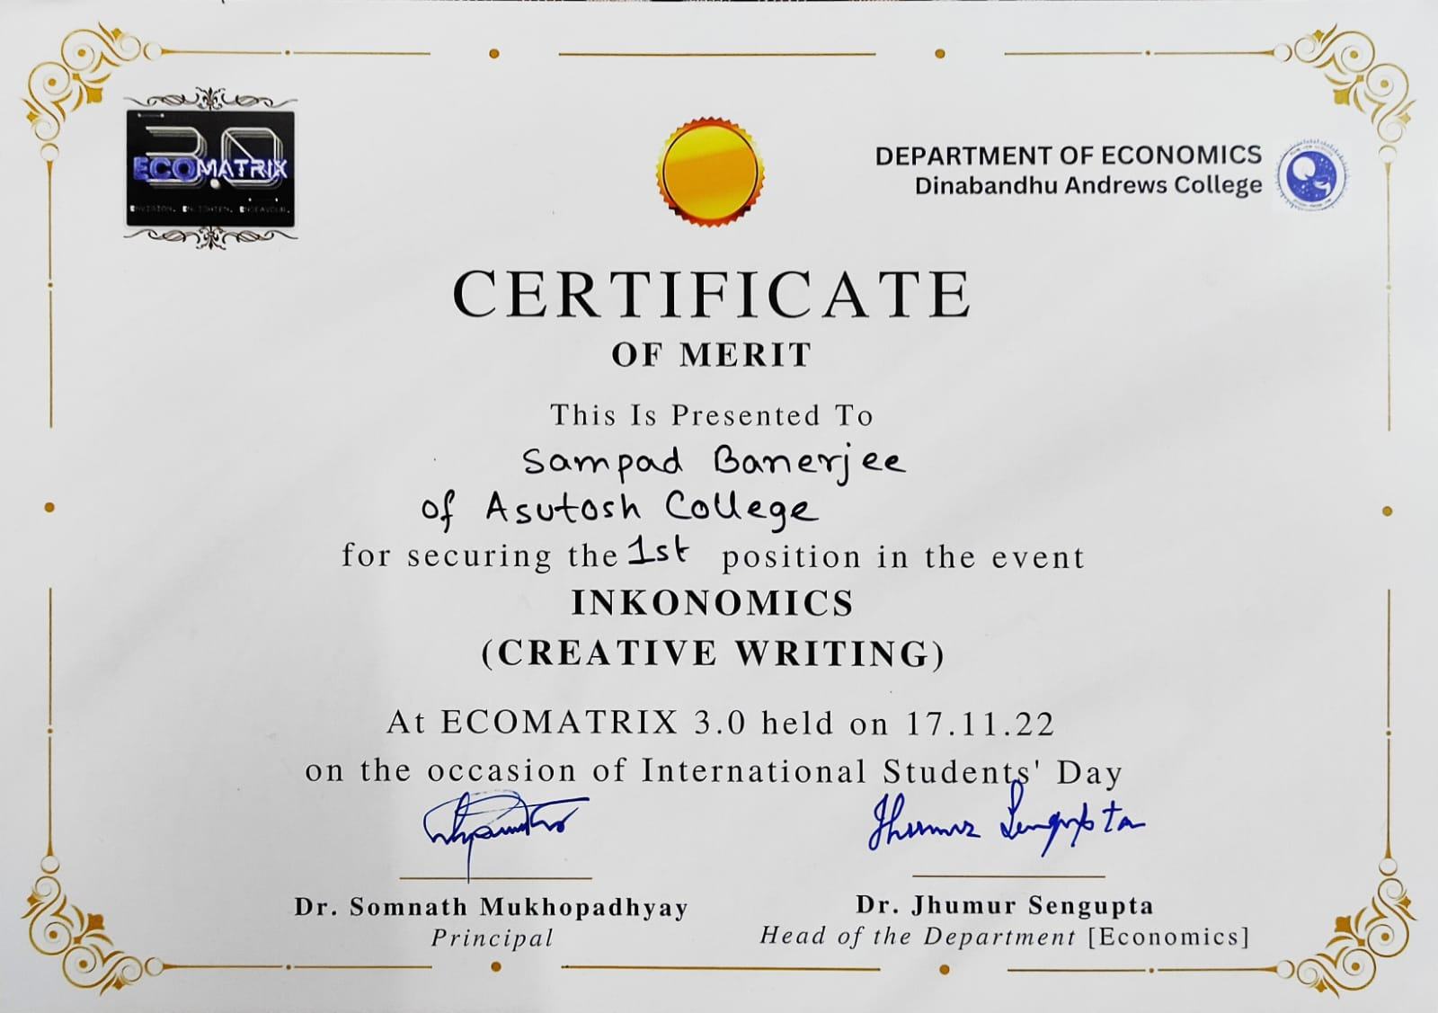
STUDENTS ACHIEVEMENT

Slide 30
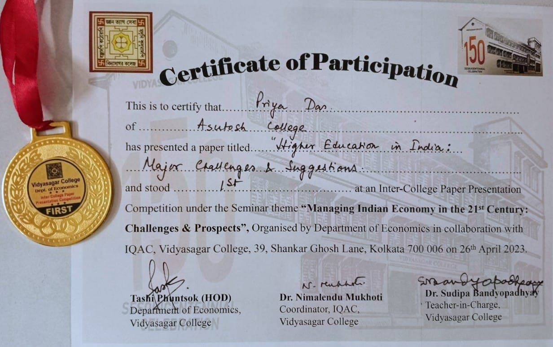
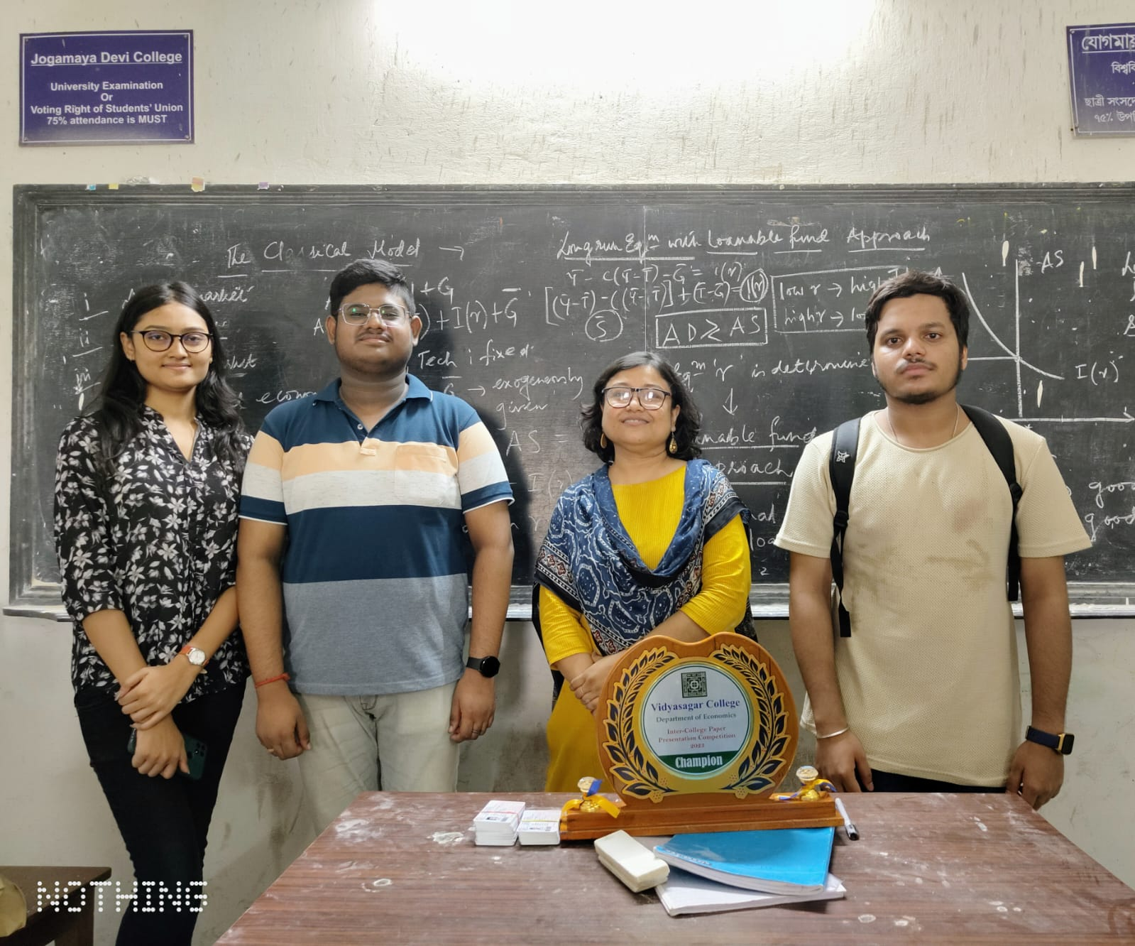

Slide 31
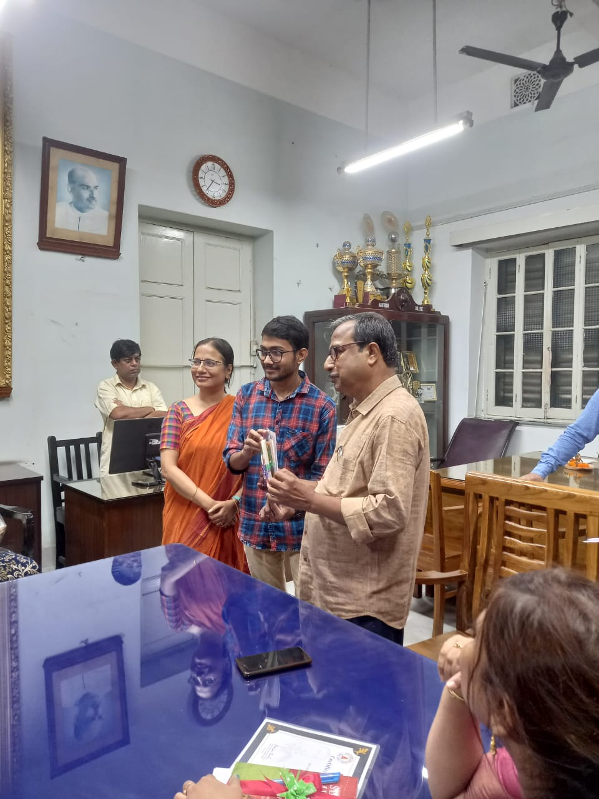
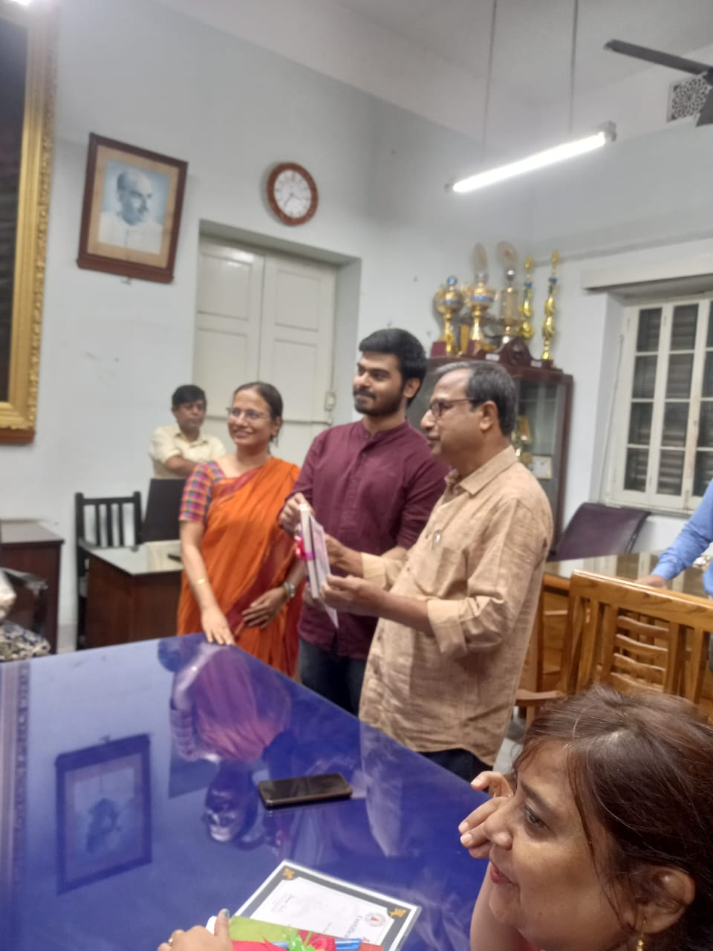
FELICITATION

Slide 32
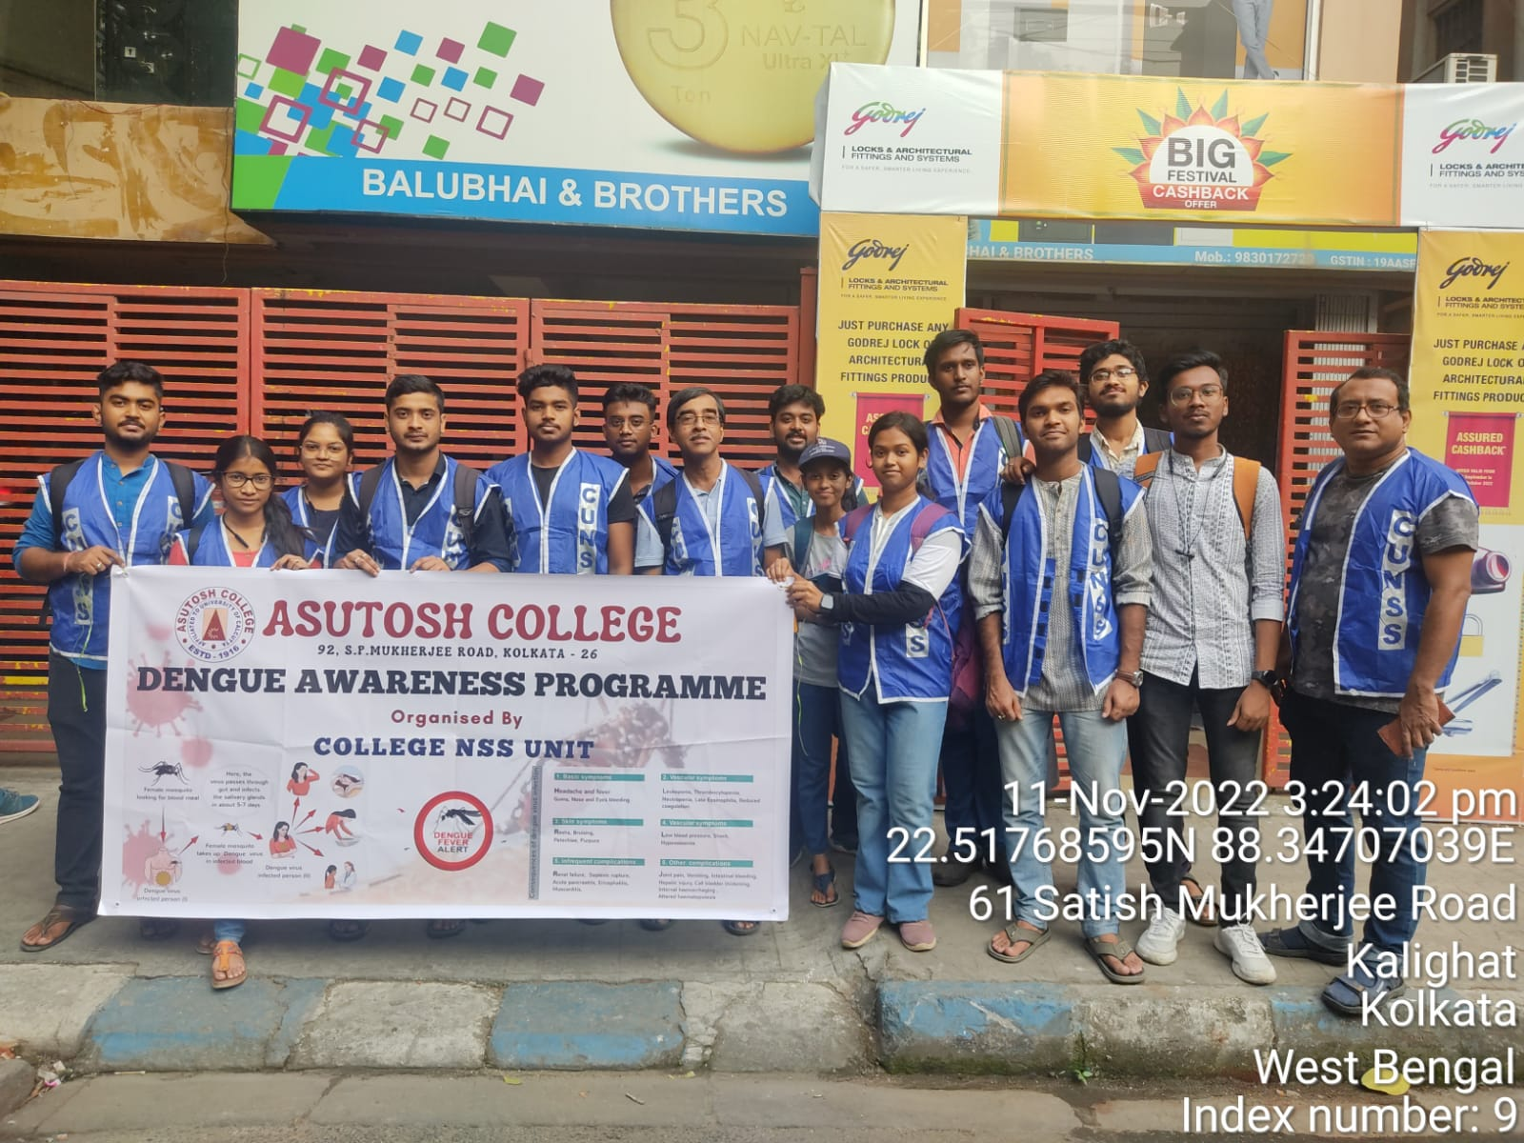
OUTREACH AND EXTENSION ACTIVITIES

Slide 33
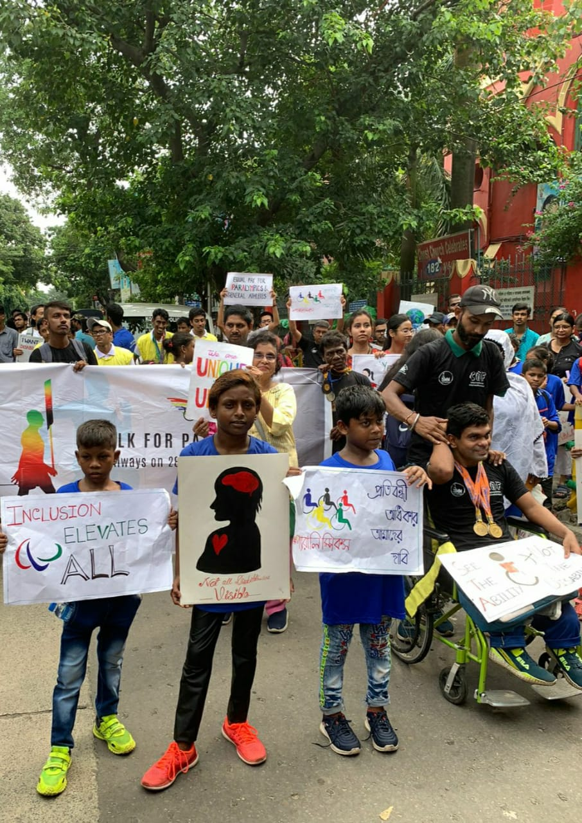
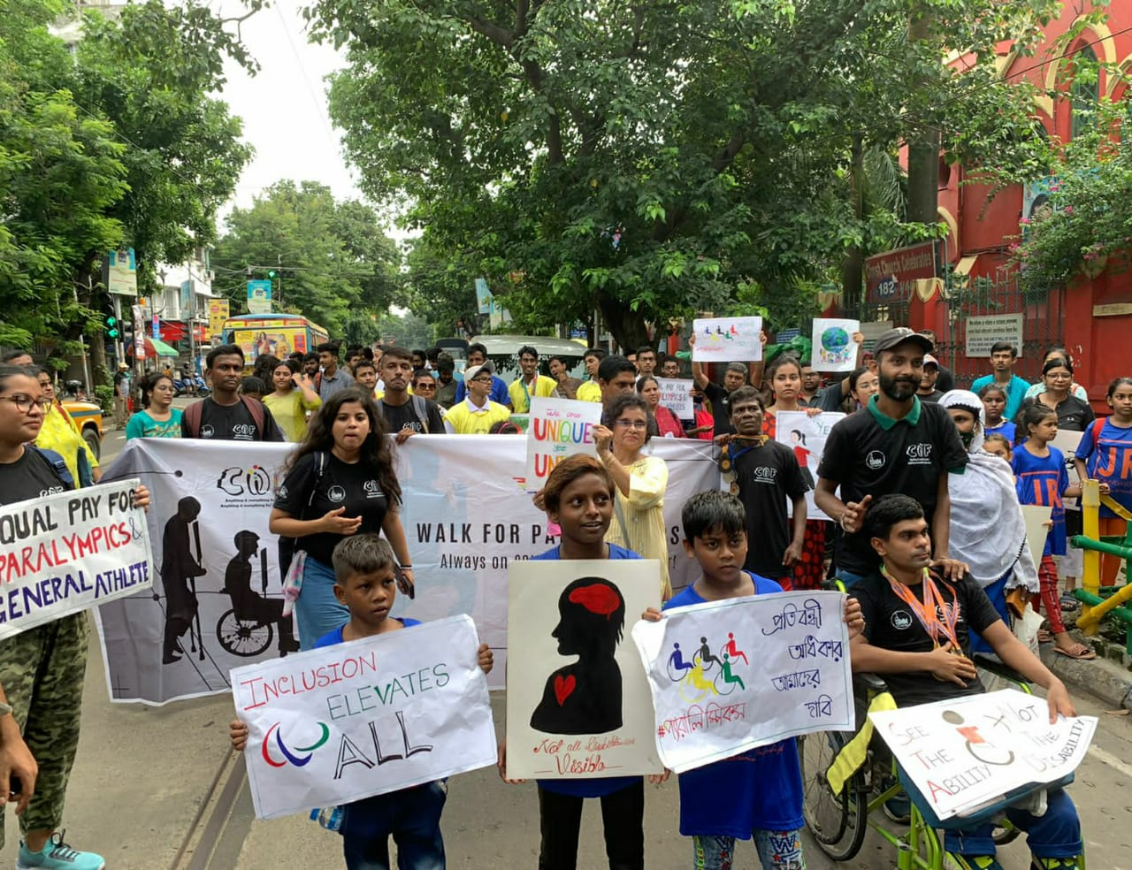

Slide 35
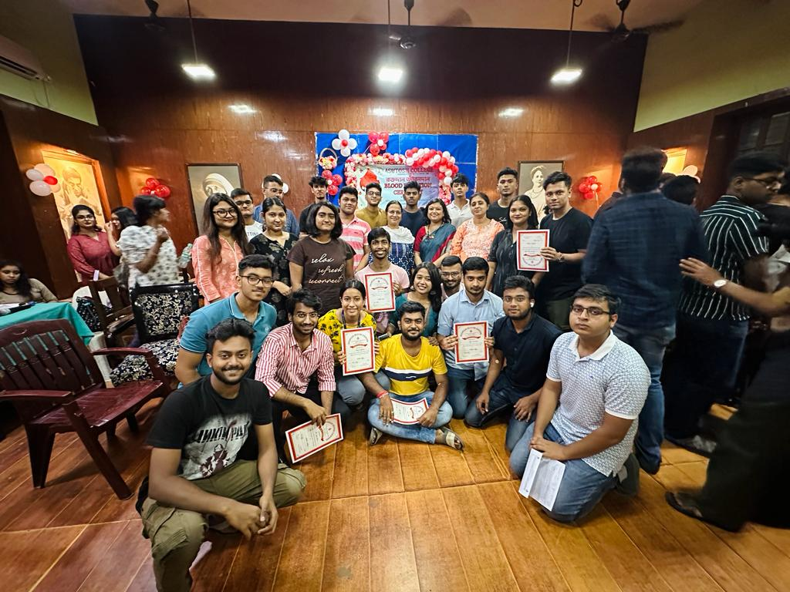
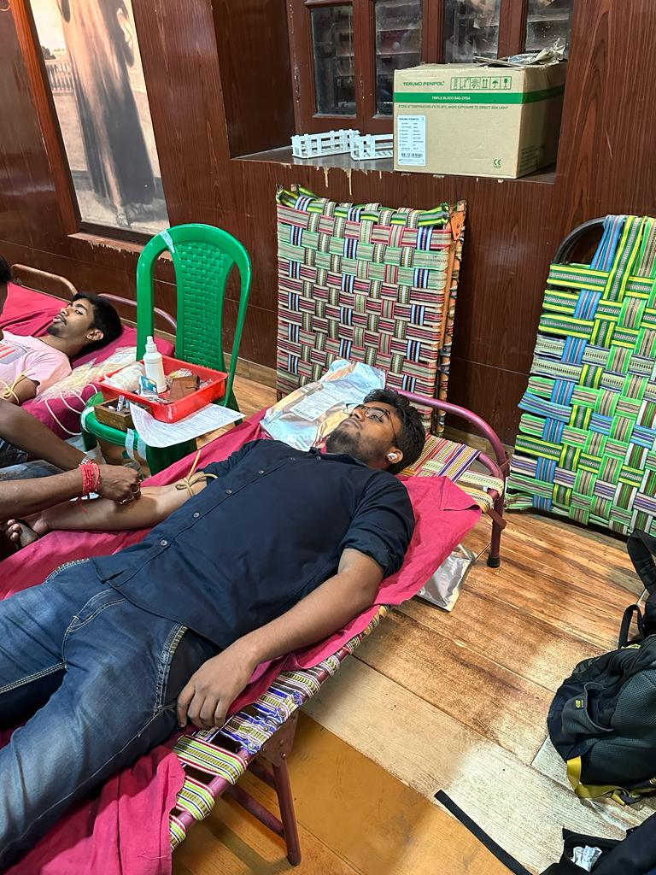
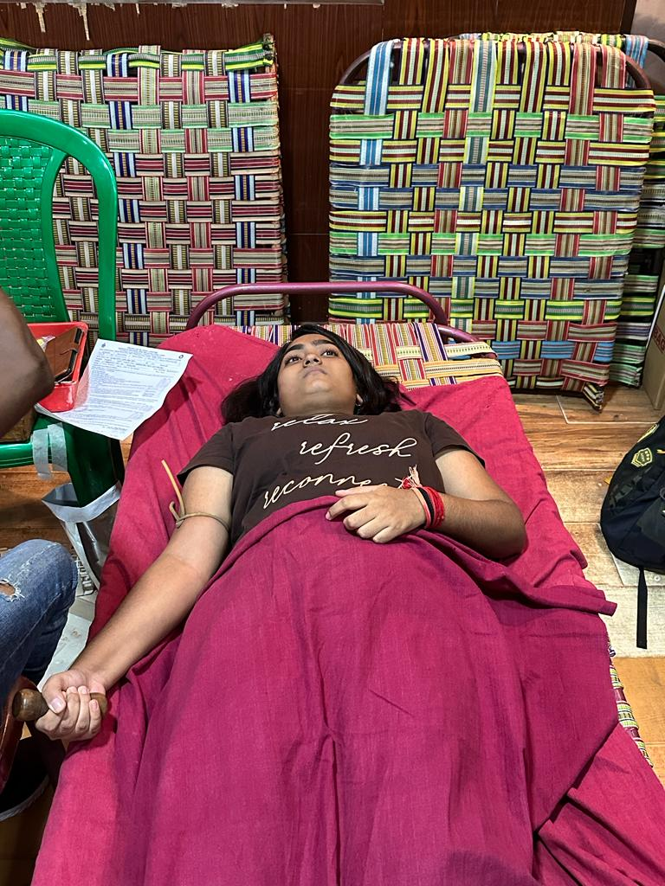
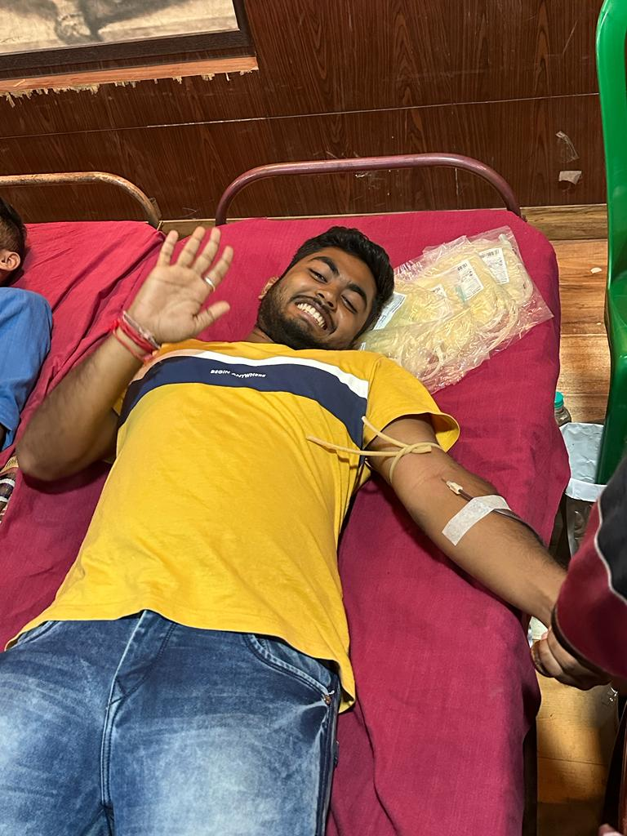

Slide 36
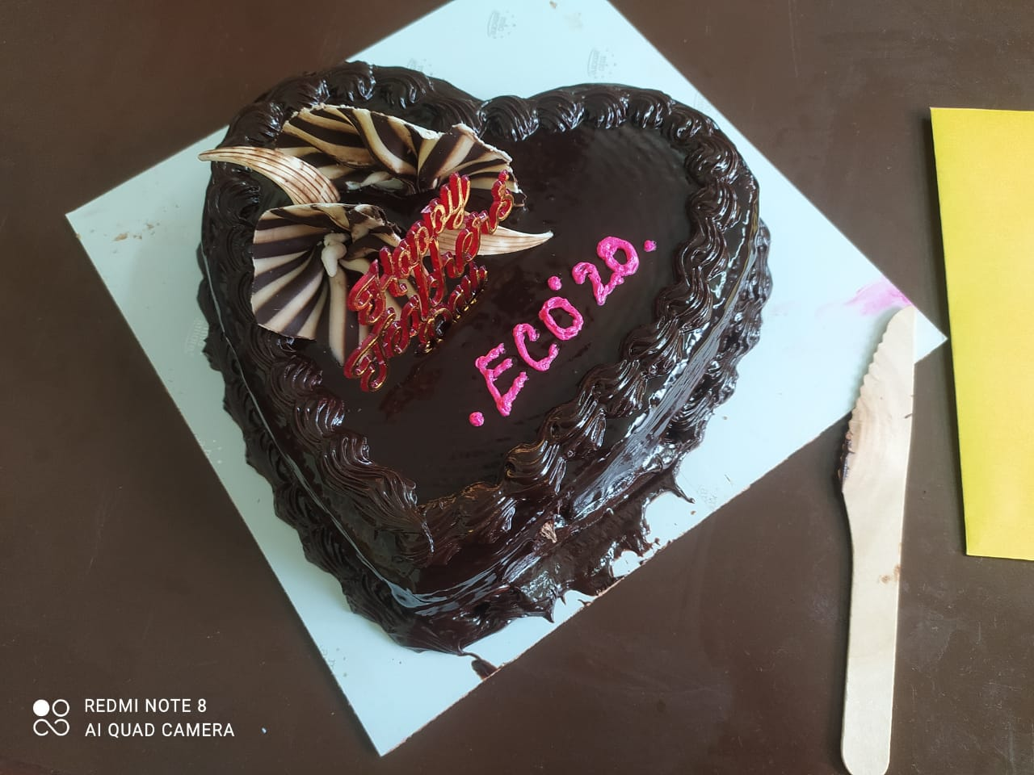
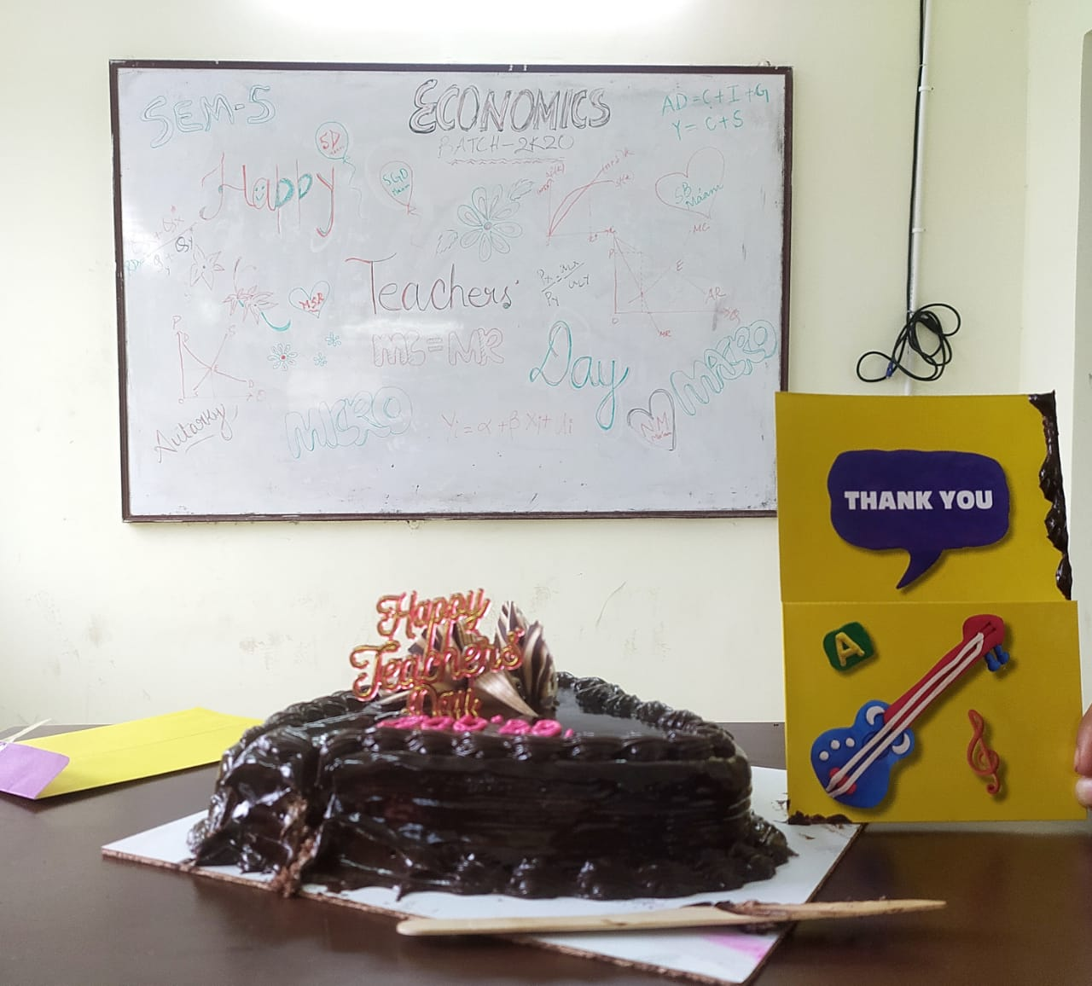
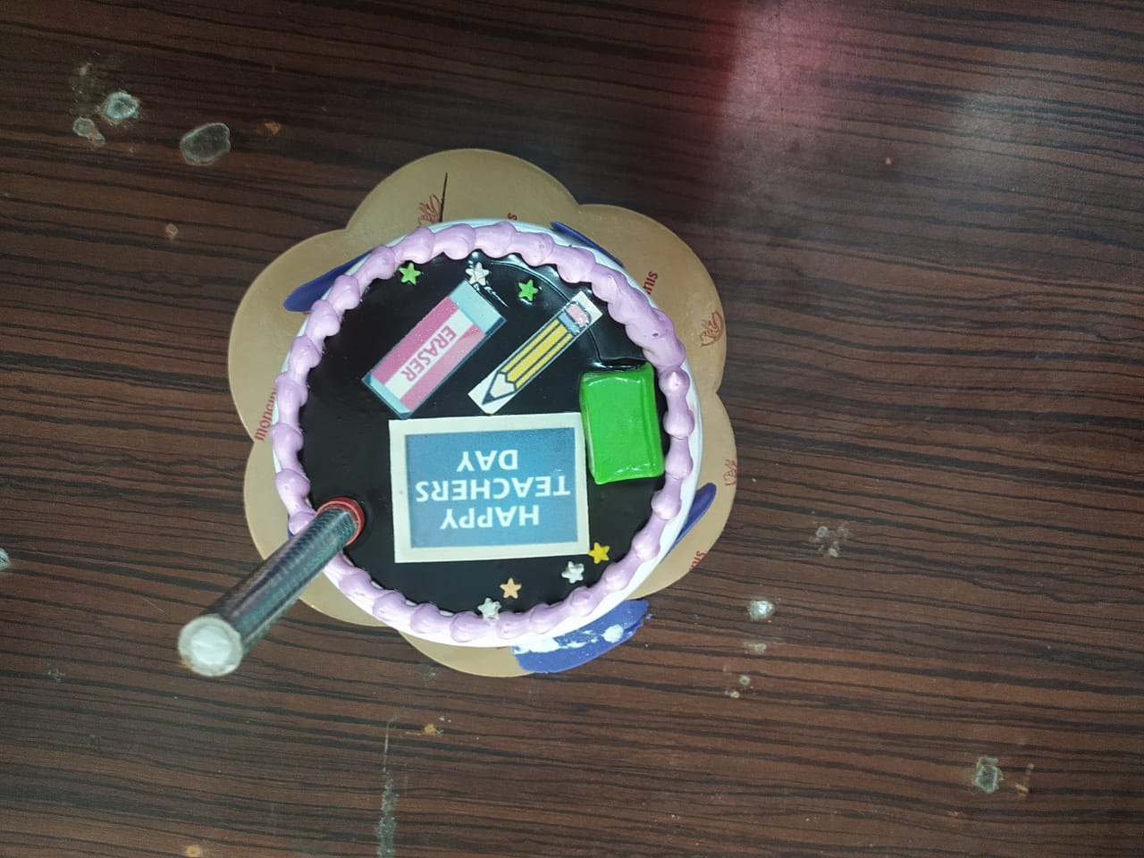
TEACHERS DAY CELEBRATION

Slide 37
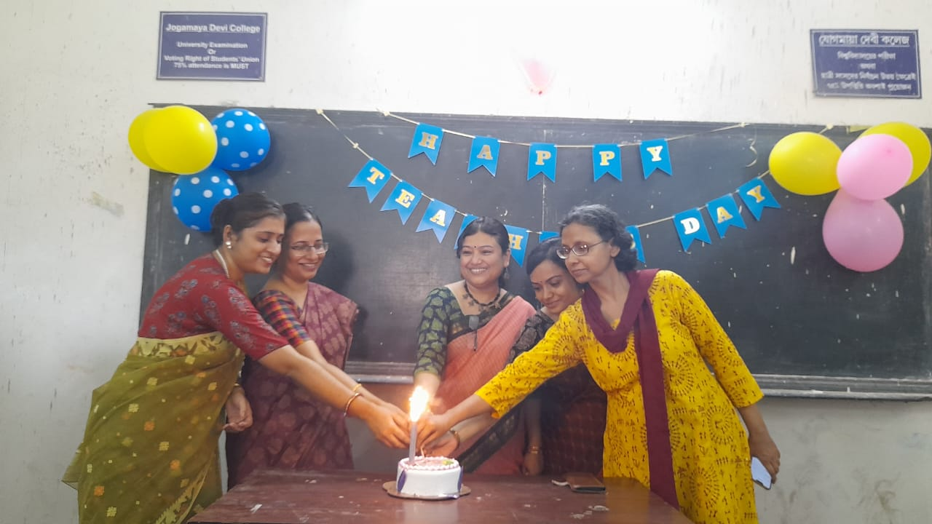
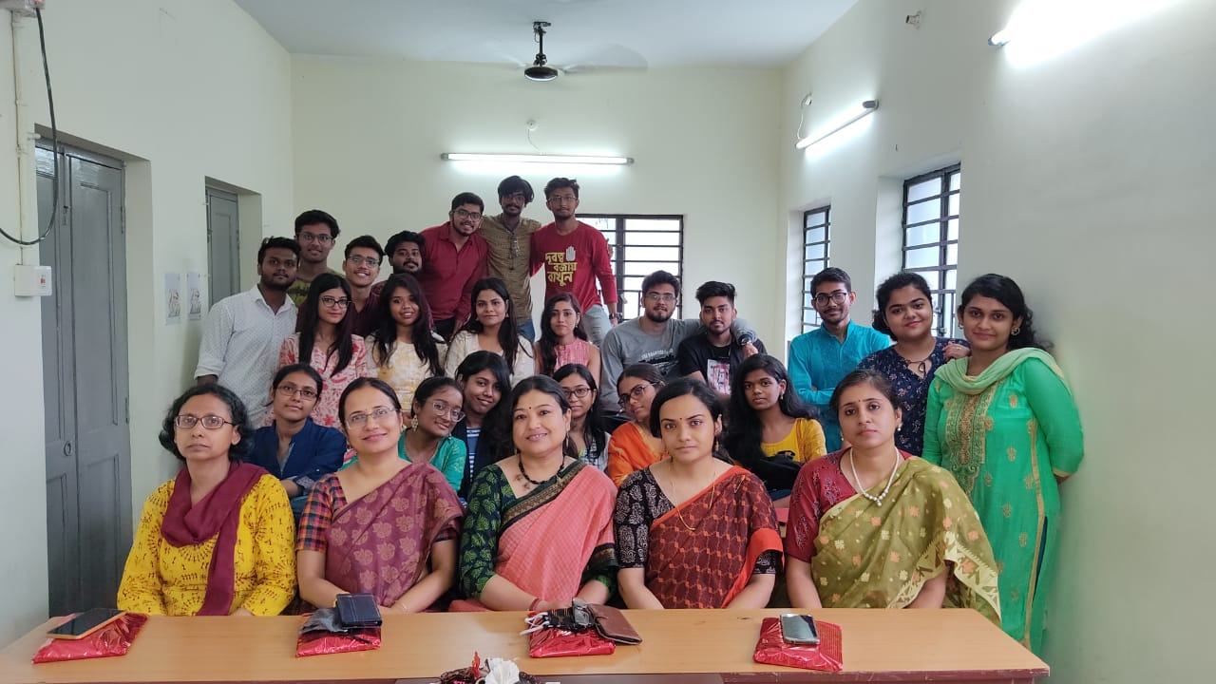

Slide 38
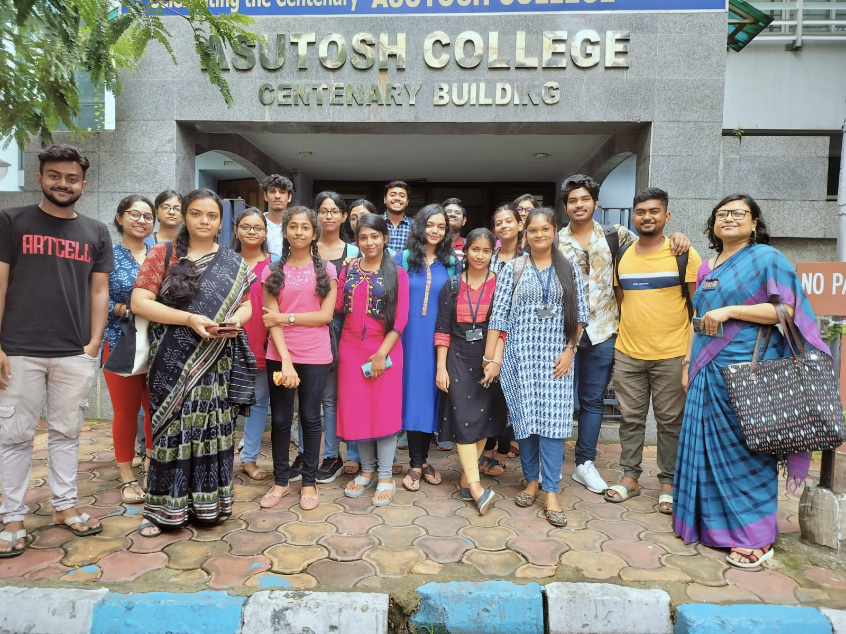
EDUCATIONAL TOUR

Slide 39
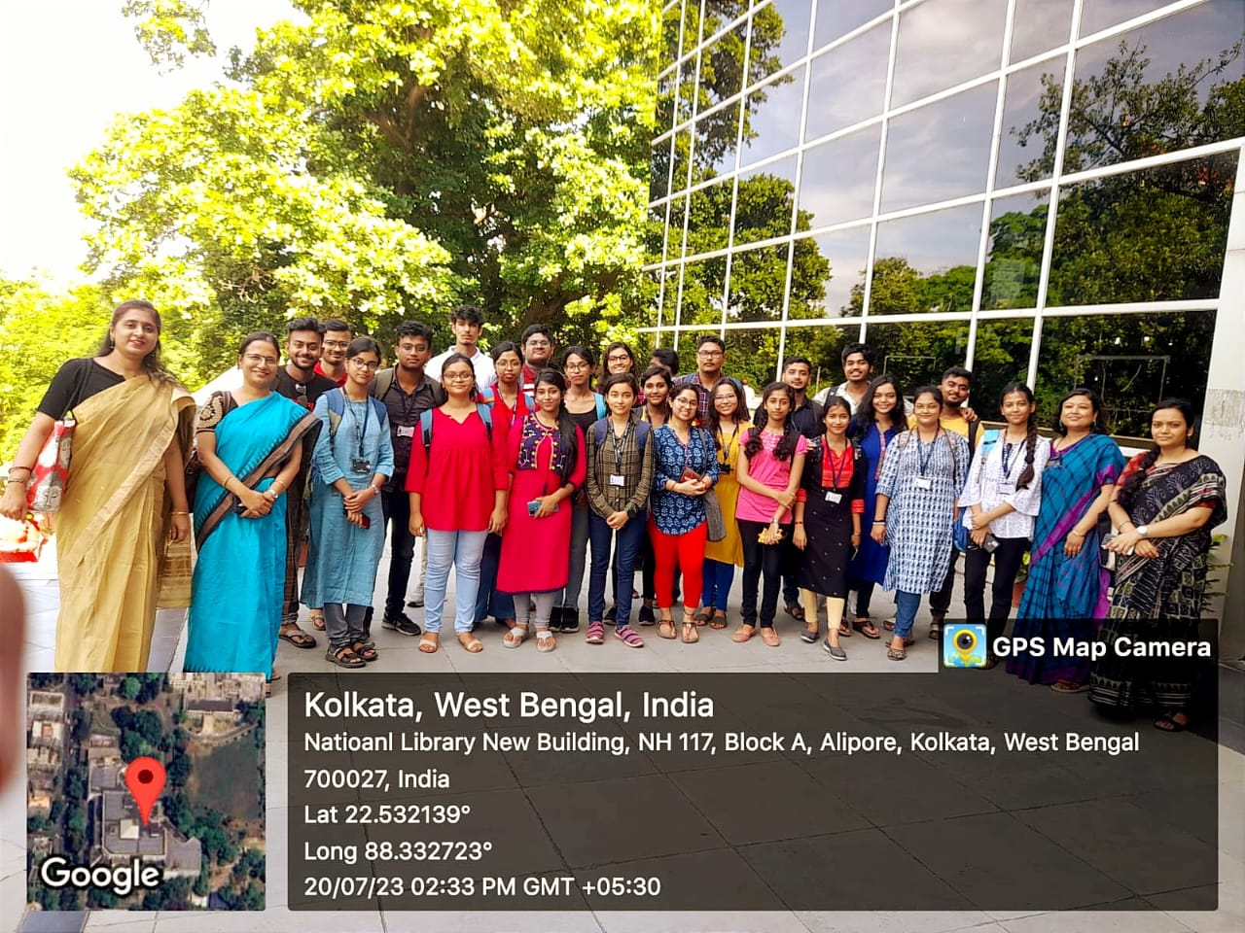

Slide 45
OUTGOING BATCH-2020-23:LAST DAY

Slide 46
FUTURE PLANS
Audio-Visual classes
Popular lecture series
Students exhibition
Hands on training
Wall magazine
Career counseling sessions

Slide 47
ALL THE BEST
THANK YOU

